Slide 1

Low-power Dynamic Logic Circuits for Flexible Electronics
Master of Electronics and ICT Engineering Technology
Jury Defense June 2025
By: Tsampanis Edmond
Supervisers: Prof. dr. ing. Myny Kris, ir. Dandekar Mohit, ing. Biesmans Jelle
In collaboration with Emerging Technologies, Systems & Security (ES&S)

Slide 2
Table of Contents
Introduction
Flexible electronics
Building logic gates
Dynamic logic
Methodology
Building dynamic logic cell
Results
Characteristics of delay cell
Discussion
Drawbacks
Delay cell
Validation circuit
Conclusion
Further work
Introduction
Methodology
Results
Discussion
Notes:
Inhoudstafel

Slide 3
Introduction

Slide 4
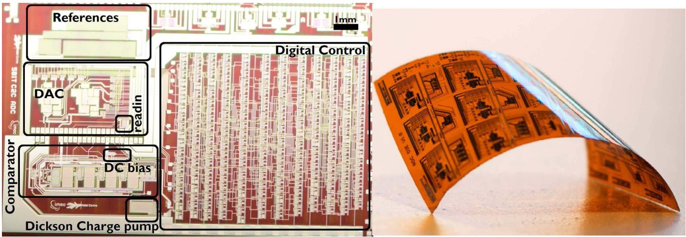
Flexible Electronics
Indium Gallium Zinc Oxide (IGZO)
Unipolar (N-type)
Characteristics [2]
Low production cost & process complexity
Highly resilient to mechanical stress
Applications
Wearable electronics & biosensors [3]
RFID tags [4]
Displays [5]
Flexible ADC [1]
Introduction
Methodology
Results
Discussion
Notes:
Kort uitleggen wat igzo is
Flex (foto)
Pros
Cons
Toepassingen
…

Slide 5
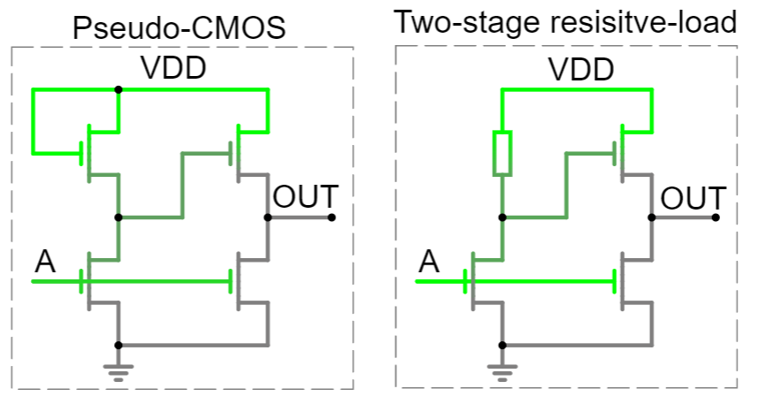
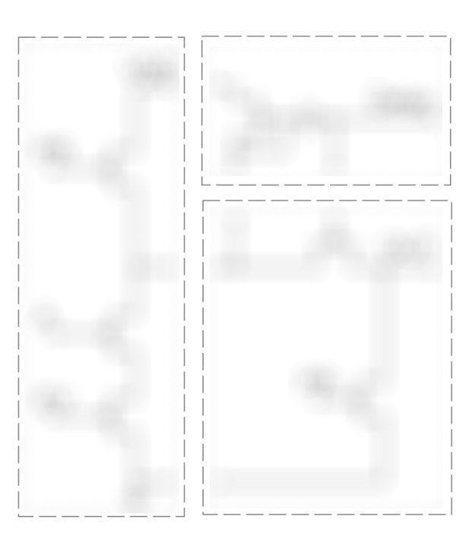
Building Logic Gates
Pseudo-CMOS [6]
Two-stage resistive-load [7]
Dynamic
Introduction
Methodology
Results
Discussion
Notes:
Complementary

Slide 6
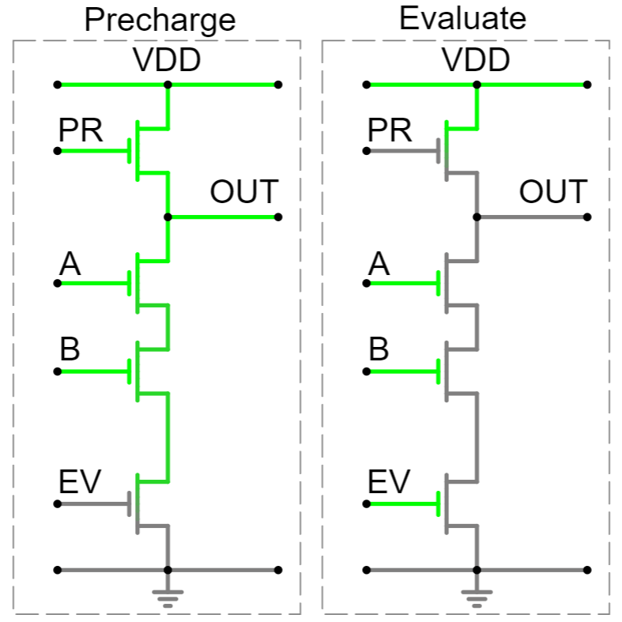
Dynamic Single-Ended Logic
Two stages
Precharge (PR)
charges output to VDD
Evaluate (EV)
checks logic computation
No direct leakage path
PR and EV do not overlap
Introduction
Methodology
Results
Discussion
Notes:
Uitleggen hoedat dynamische logica werkt in cmos:
Precharge
Evaluate
No direct path for short circuit
Pull-down network
Prechrage to VDD
Evaluate discharges output because of logic inputs
Pull-up network
Precharge to GND
Evaluate charges output because of logic inputs

Slide 7
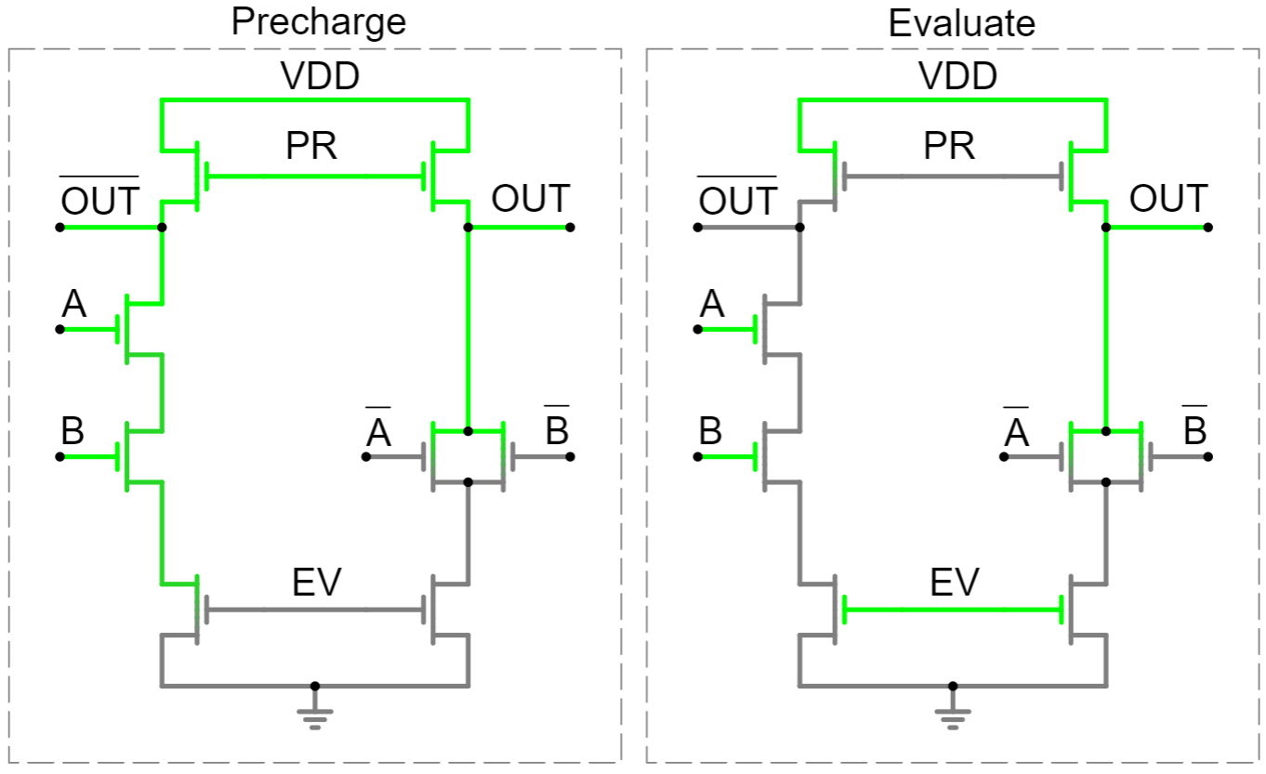
Dynamic Differential Logic
Computes output and complement
Same functionality as single-ended (previous example)
Pull-down network
Precharge to VDD
One output changes state
Monitor logic cell’s computation
Introduction
Methodology
Results
Discussion
Notes:
Differentiele logica uitleggen: aanhalen van de 2x precharge naar 1 en pulldown van 1 output

Slide 8
Methodology

Slide 9
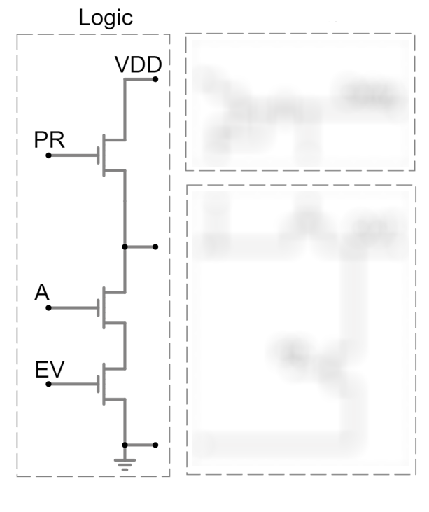
Modifications to Conventional Logic Cell
Introduction
Methodology
Results
Discussion
Notes:
Differentiele logica uitleggen: aanhalen van de 2x precharge naar 1 en pulldown van 1 output

Slide 10
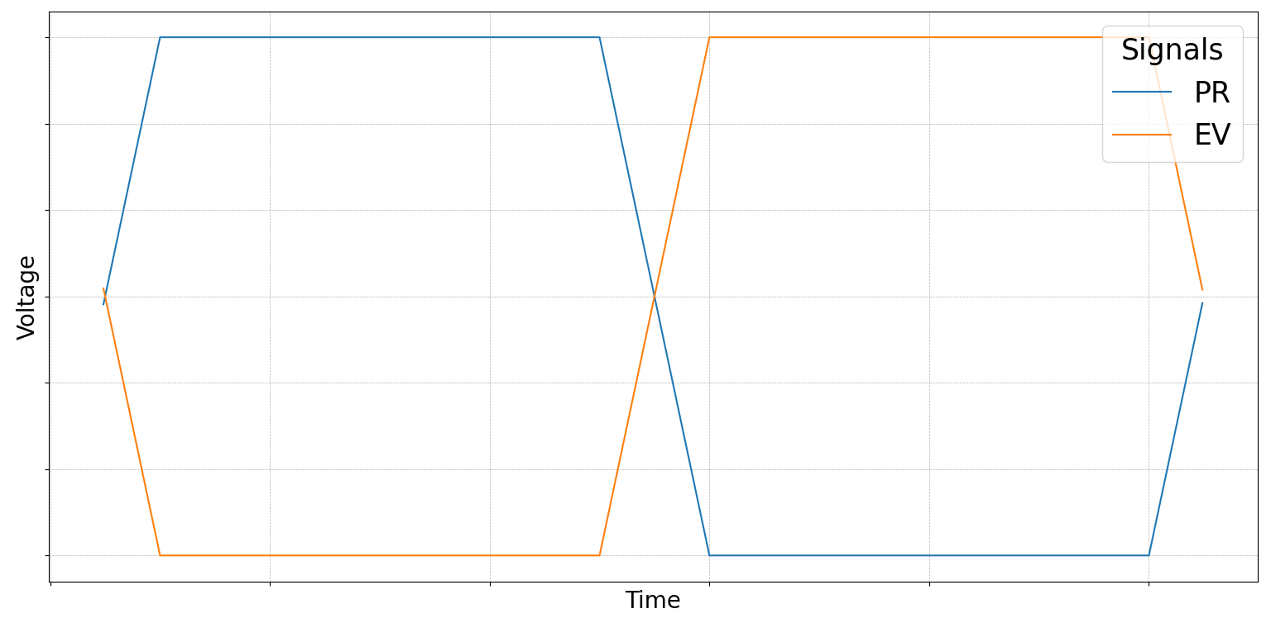
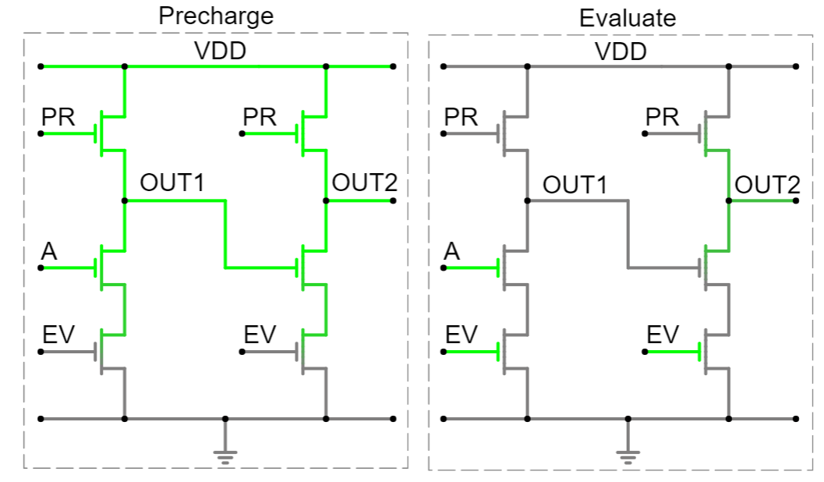
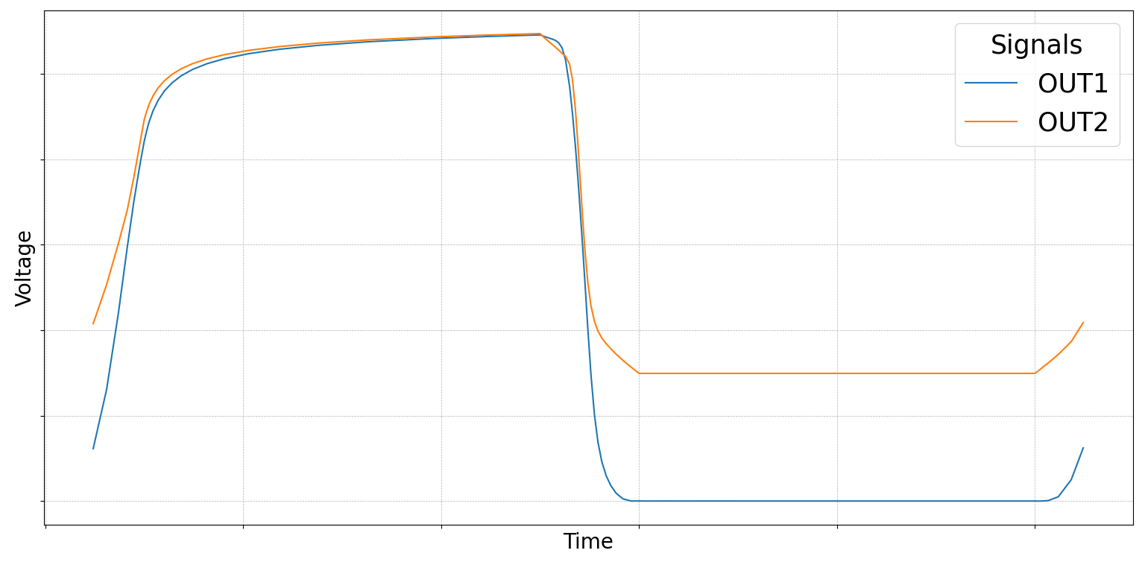
Premature Node Discharge
Voltage
Voltage
Time
Introduction
Methodology
Results
Discussion
Notes:
Differentiele logica uitleggen: aanhalen van de 2x precharge naar 1 en pulldown van 1 output

Slide 11
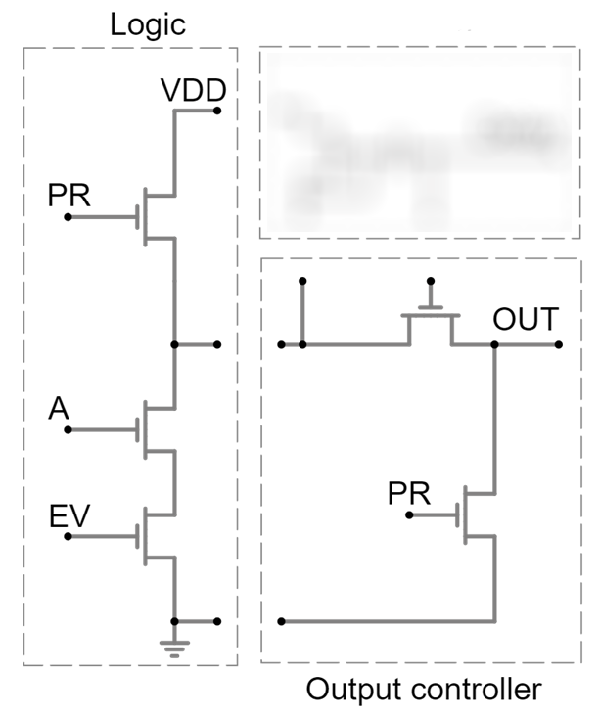
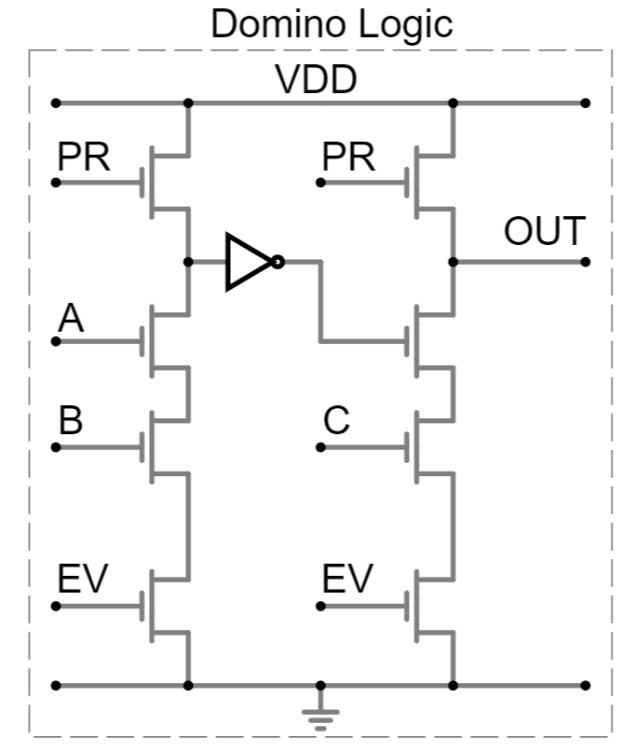

Modifications to Conventional Logic Cell
Introduction
Methodology
Results
Discussion
Notes:
Differentiele logica uitleggen: aanhalen van de 2x precharge naar 1 en pulldown van 1 output

Slide 12
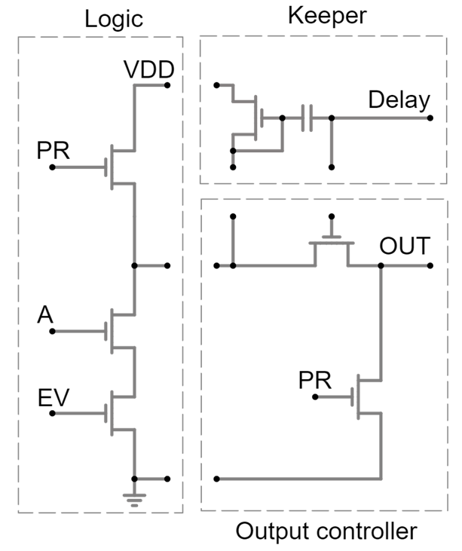
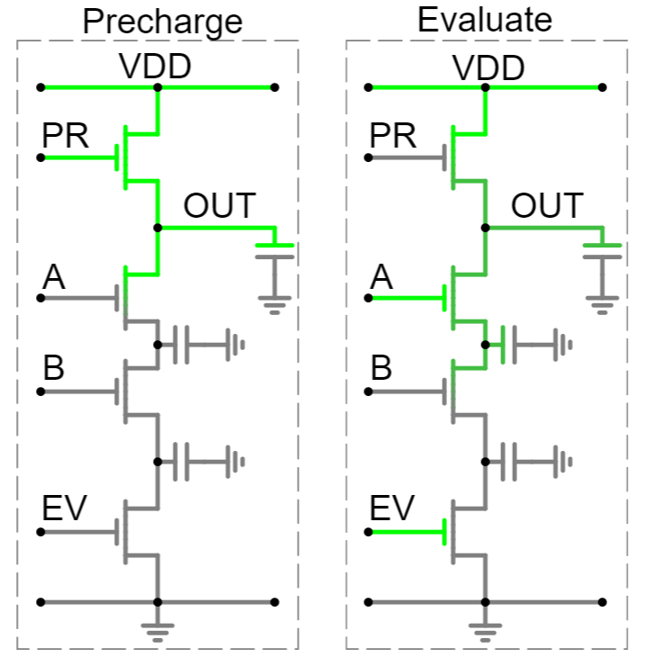
Charge Sharing
Introduction
Methodology
Results
Discussion
Notes:
Differentiele logica uitleggen: aanhalen van de 2x precharge naar 1 en pulldown van 1 output

Slide 13
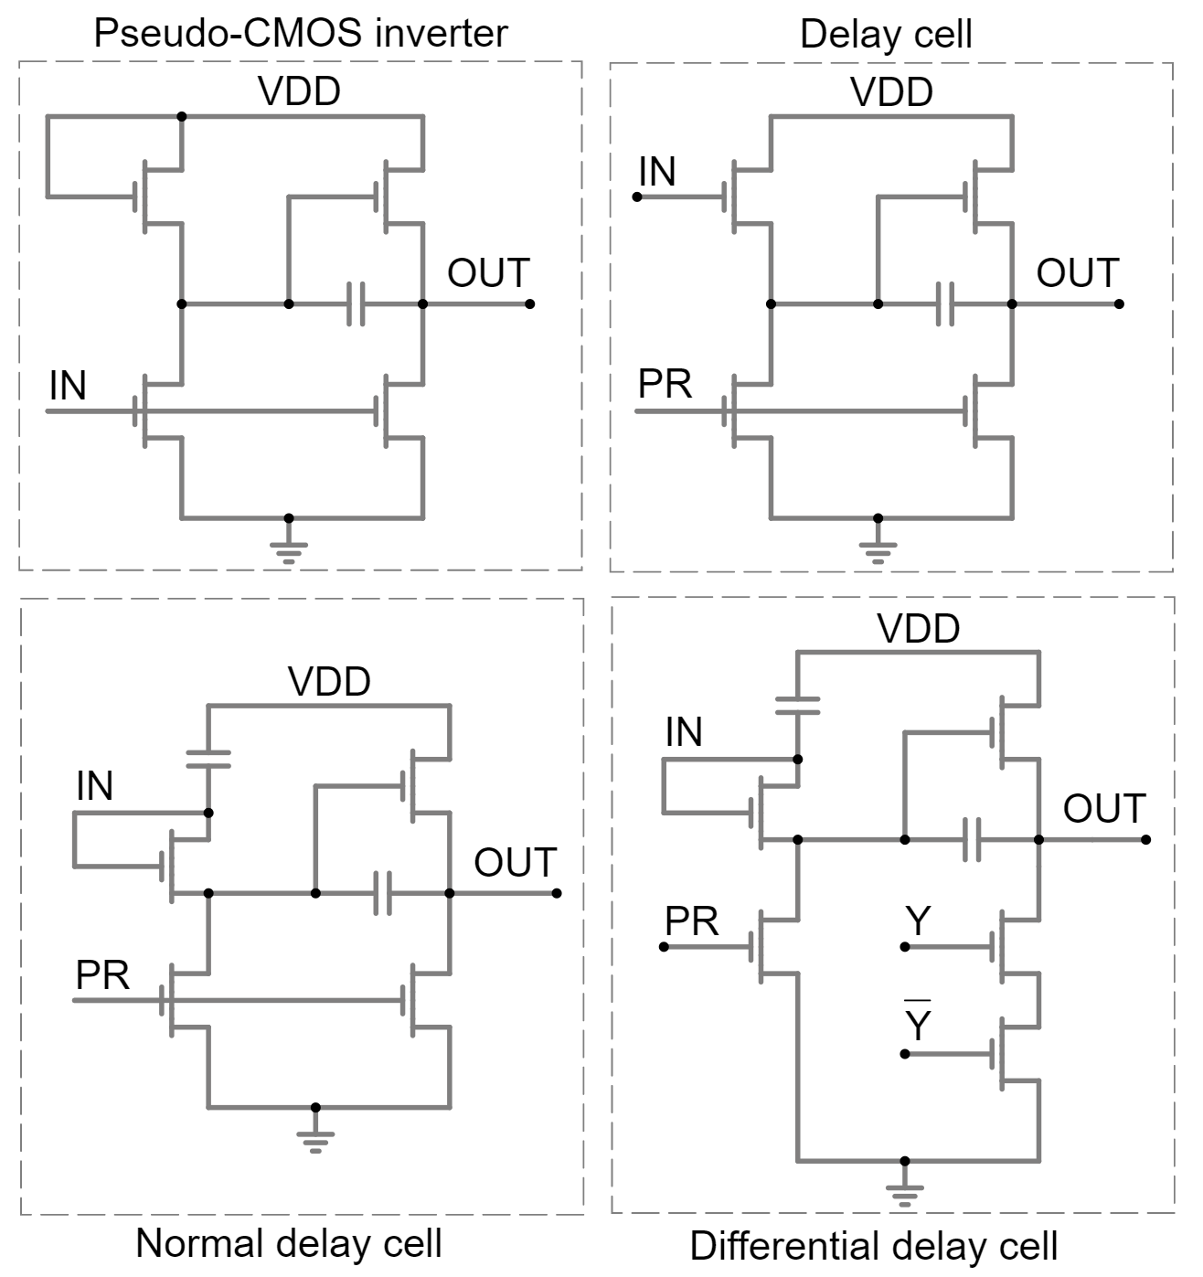
Delay Cell
Pseudo-CMOS bootstrapped inverter [8]
Bootstrapping [9]
Voltage swing
Delay
Normal delay cell
Buffer (input = output)
Differential delay cell
NAND (checks computation state)
Introduction
Methodology
Results
Discussion
Notes:
Delay cell:
Afgestamd van pseudo-cmos bootstrap inverter (evo)

Slide 14
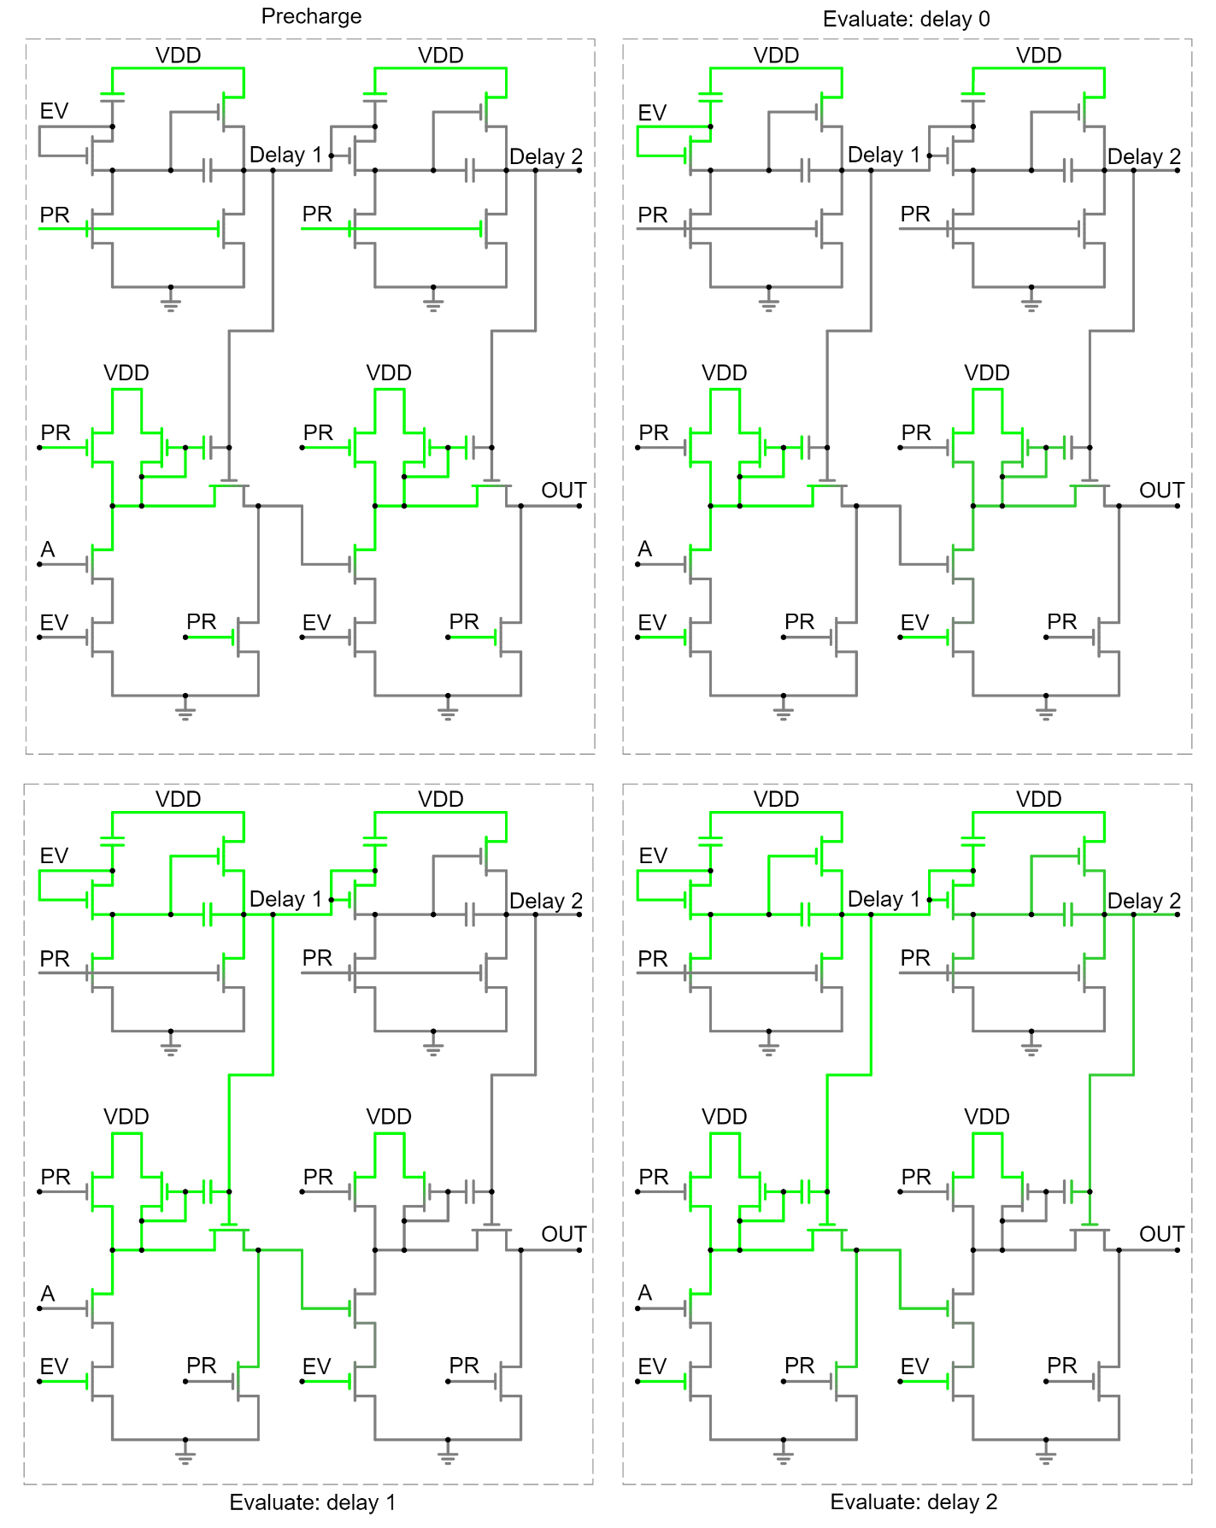
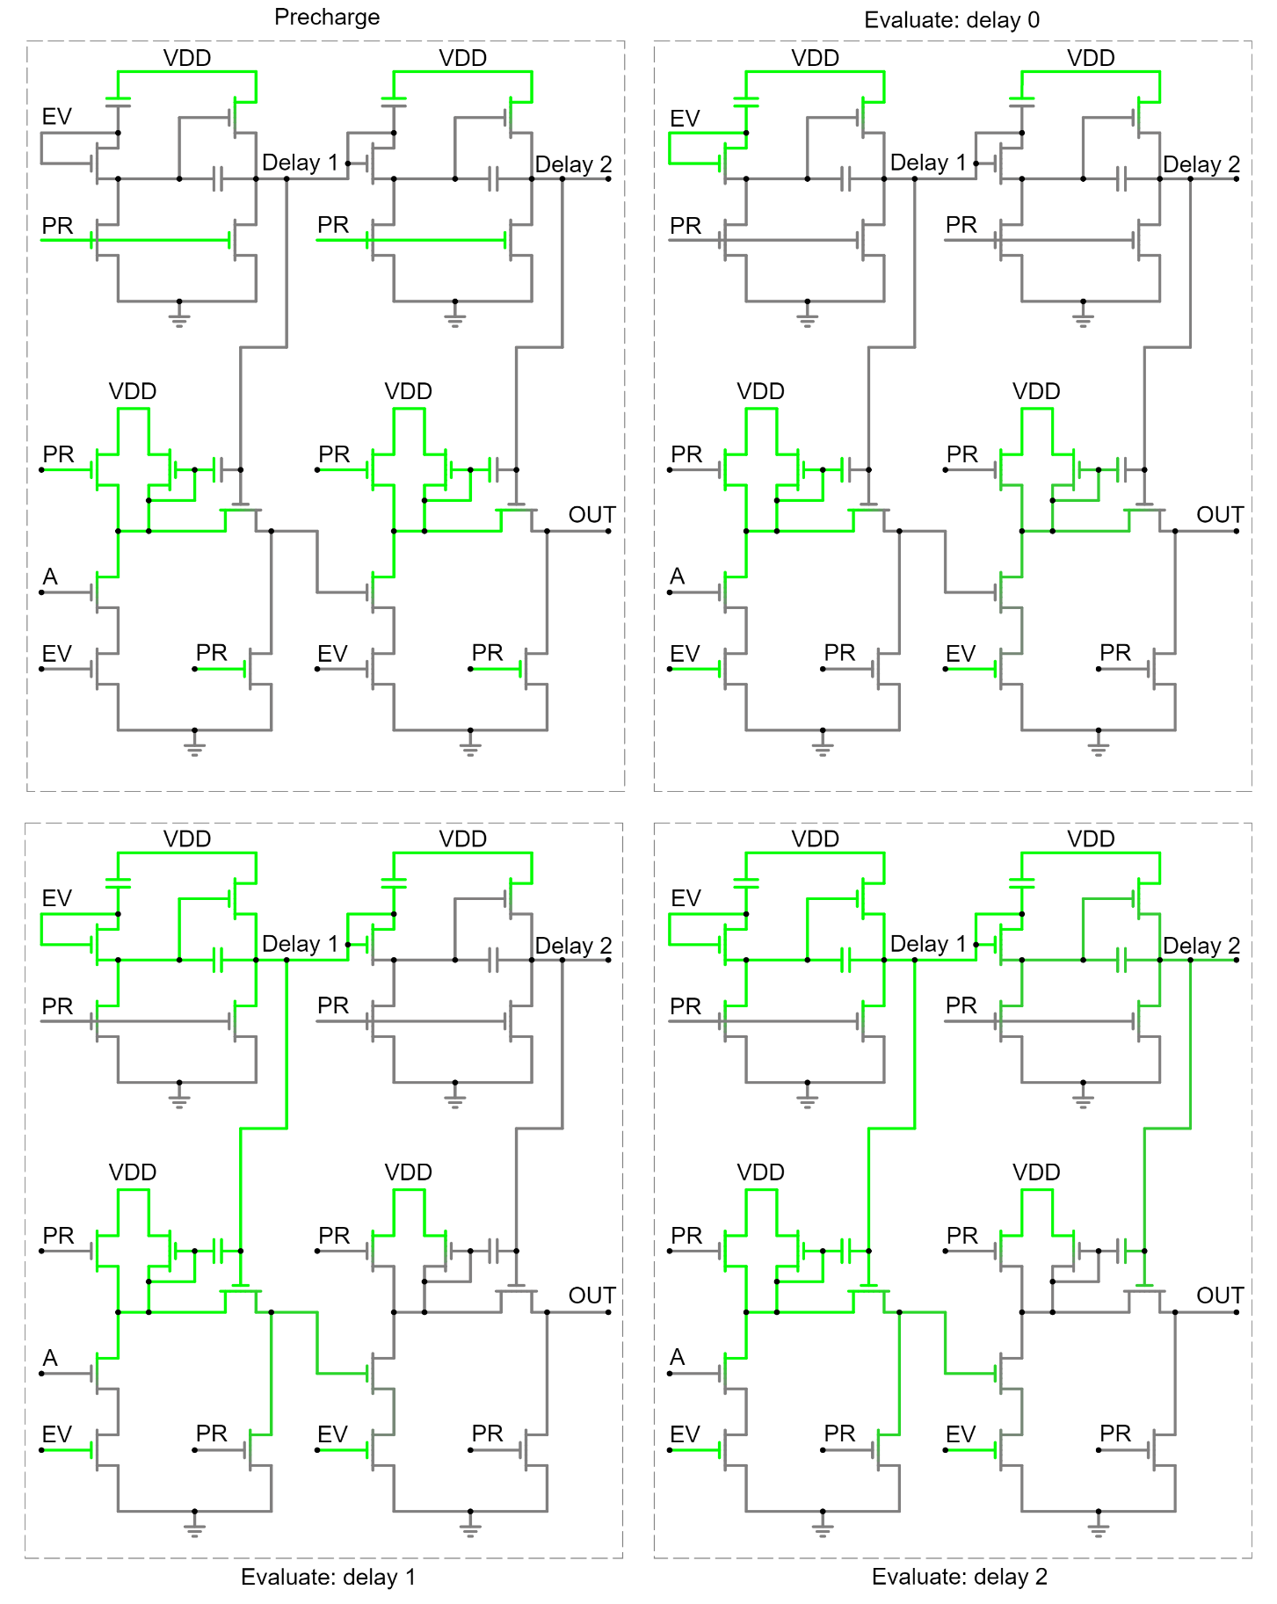
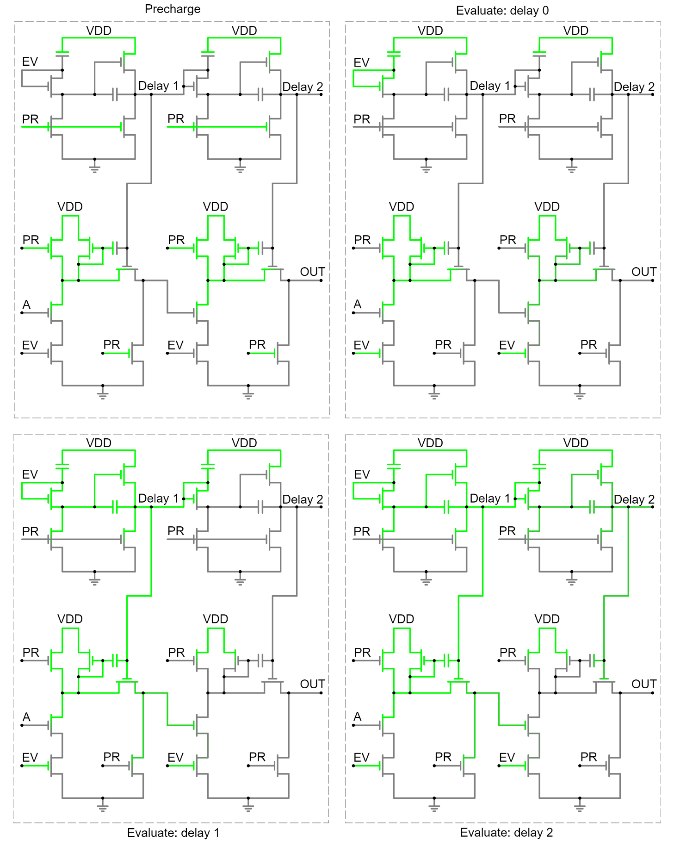
Example Single-Ended Dynamic Logic
Precharge
Evaluate: delay 0
Evaluate: delay 1
Evaluate: delay 2
Introduction
Methodology
Results
Discussion
Notes:
Voorbeeld single-ended logic

Slide 15
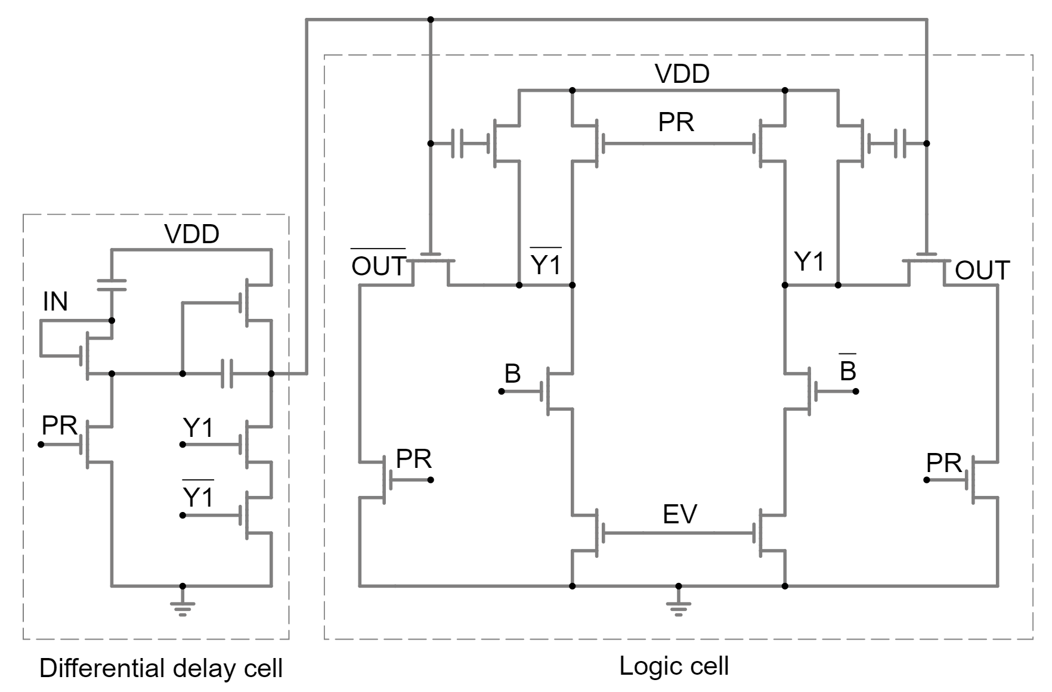
Example Differential Dynamic Logic
Introduction
Methodology
Results
Discussion

Slide 16
Results

Slide 17
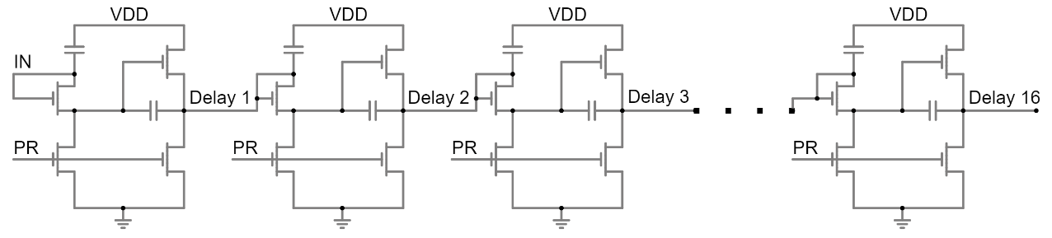
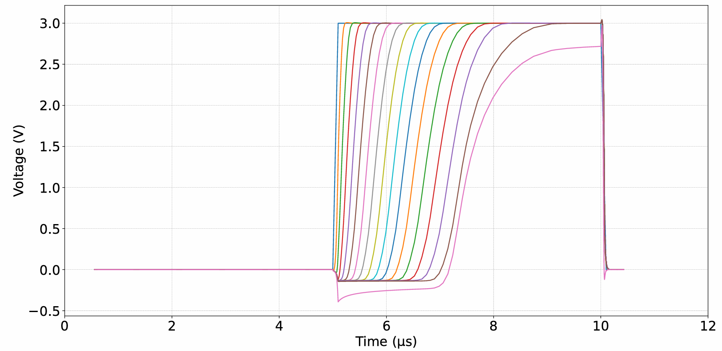
Characteristics of Delay Cell
Constant delay:
250 ns delay for 3 V
Depends on supply voltage
Depends on load
Introduction
Methodology
Results
Discussion
Notes:
Schema 16-stage chain + grafiek (potentieel andere grafieken ook, hangt af van tijd)

Slide 18
Validation
4-bit adder
Circuit
Flip-flops at I/O
2RLL (fast & slow)
Logic styles
Dynamic (single-ended & differential)
Metrics
Power
Area
Speed
Introduction
Methodology
Results
Discussion
Notes:
Manier van validatie:
Circuit: Pipelined 4-bit adder
Baseline: 2RLL
Proposed: dynamic
Main: power
Side: speed
Side area

Slide 19
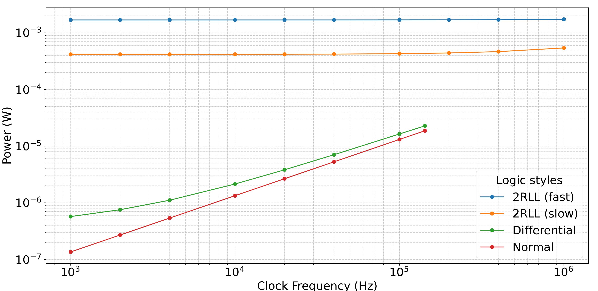
Power Consumption and Operational Speed
7x
19x
100x
Introduction
Methodology
Results
Discussion
Notes:
Grafiek power

Slide 20
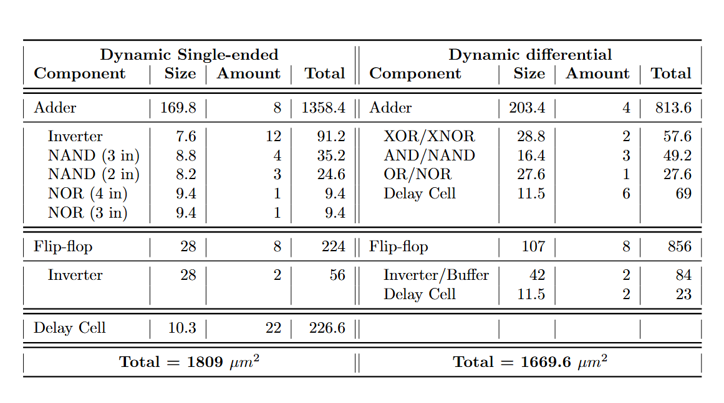
Area Comparison
1.5x - 2x
smaller
Introduction
Methodology
Results
Discussion
Notes:
Tabbellen area

Slide 21

Conclusion
Objectives
Improved power efficiency for logic in IGZO
Similar speed and area to static logic
7x
19x
100x
Introduction
Methodology
Results
Discussion
Notes:
conclusie

Slide 22
Discussion

Slide 23
Discussion
Drawbacks
Difficult design flow
Future work
Design of a better delay cell
Check robustness of delay cell
Clock tree
Limited speed by delay cell
Creation of a layout
Introduction
Methodology
Results
Discussion
Notes:
conclusie

Slide 24
References
[1] N. P. Papadopoulos, F. De Roose, J.-L. P. van der Steen, E. C. Smits, M. Ameys, W. Dehaene, J. Genoe, and K. Myny, “Toward temperature tracking with unipolar metal-oxide thin-film sar c-2c adc on plastic,” IEEE Journal of Solid-State Circuits, vol. 53, no. 8, pp. 2263–2272, 2018.
[2] K. Myny, “The development of flexible integrated circuits based on thin-film transistors,”Nature Electronics 2017 1:1, vol. 1, no. 1, pp. 30–39, 1 2018. [Online]. Available:https://www.nature.com/articles/s41928-017-0008-6
[3] Z. Mohammad, S. Stefano, R. Ganesh, S. Smout, W. Myriam, M. Kris, and C. Eugenio, “Aflexible ECG patch compatible with NFC RF communication,” NPJ Flexible Electronics,vol. 4, no. 1, 2020.
[4] PragmatIC, “PragmatIC RFID.” [Online]. Available: https://www.pragmaticsemi.com/nfc-connect/pr1301/
[5] Y. Hara, T. Kikuchi, H. Kitagawa, J. Morinaga, H. Ohgami, H. Imai, T. Daitoh, andT. Matsuo, “IGZO-TFT technology for large-screen 8K display,” Journal of the Society forInformation Display, vol. 26, no. 3, pp. 169–177, 3 2018.
[6] T. C. Huang, K. Fukuda, C. M. Lo, Y. H. Yeh, T. Sekitani, T. Someya, and K. T. Cheng,“Pseudo-CMOS: A design style for low-cost and robust flexible electronics,” IEEE Transac-tions on Electron Devices, vol. 58, no. 1, pp. 141–150, 1 2011.
[7] H. Celiker, A. Sou, W. Dehaene, and K. Myny, “Two-Stage Resistor-Load Logic for Digi-tal Applications on Flexible Substrates,” in FLEPS 2021 - IEEE International Conferenceon Flexible and Printable Sensors and Systems. Institute of Electrical and ElectronicsEngineers Inc., 6 2021.
[8] B. Tiwari, P. Bahubalindruni, A. Santos, A. Santa, C. Figueiredo, M. Pereira, R. Martins,E. Fortunato, and P. Barquinha, “Low-Voltage High-Speed Ring Oscillator with a-InGaZnOTFTs,” IEEE Journal of the Electron Devices Society, vol. PP, p. 1, 5 2020.
[9] D. Geng, Y. F. Chen, M. Mativenga, and J. Jang, “30 μm -Pitch Oxide TFT-Based GateDriver Design for Small-Size, High-Resolution, and Narrow-Bezel Displays,” IEEE ElectronDevice Letters, vol. 36, no. 8, pp. 805–807, 2015.
Notes:
Referenties

Slide 25
Thanks for Listening
Any Questions?

Slide 27
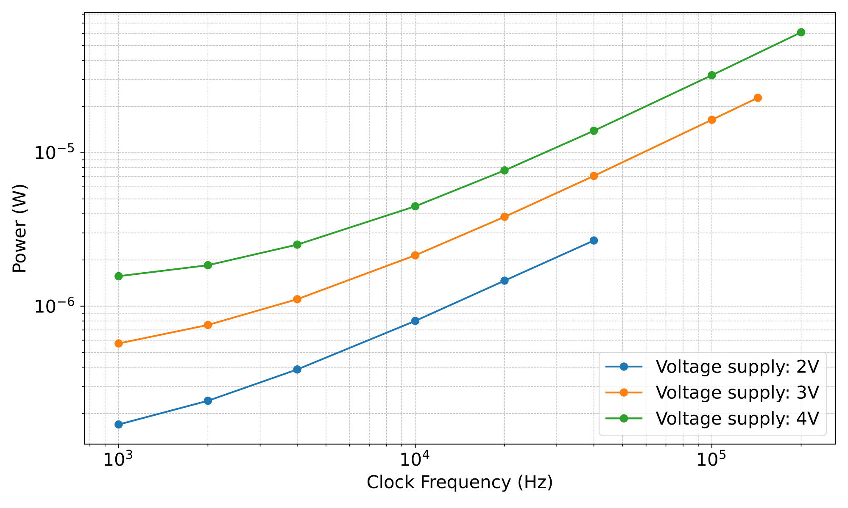
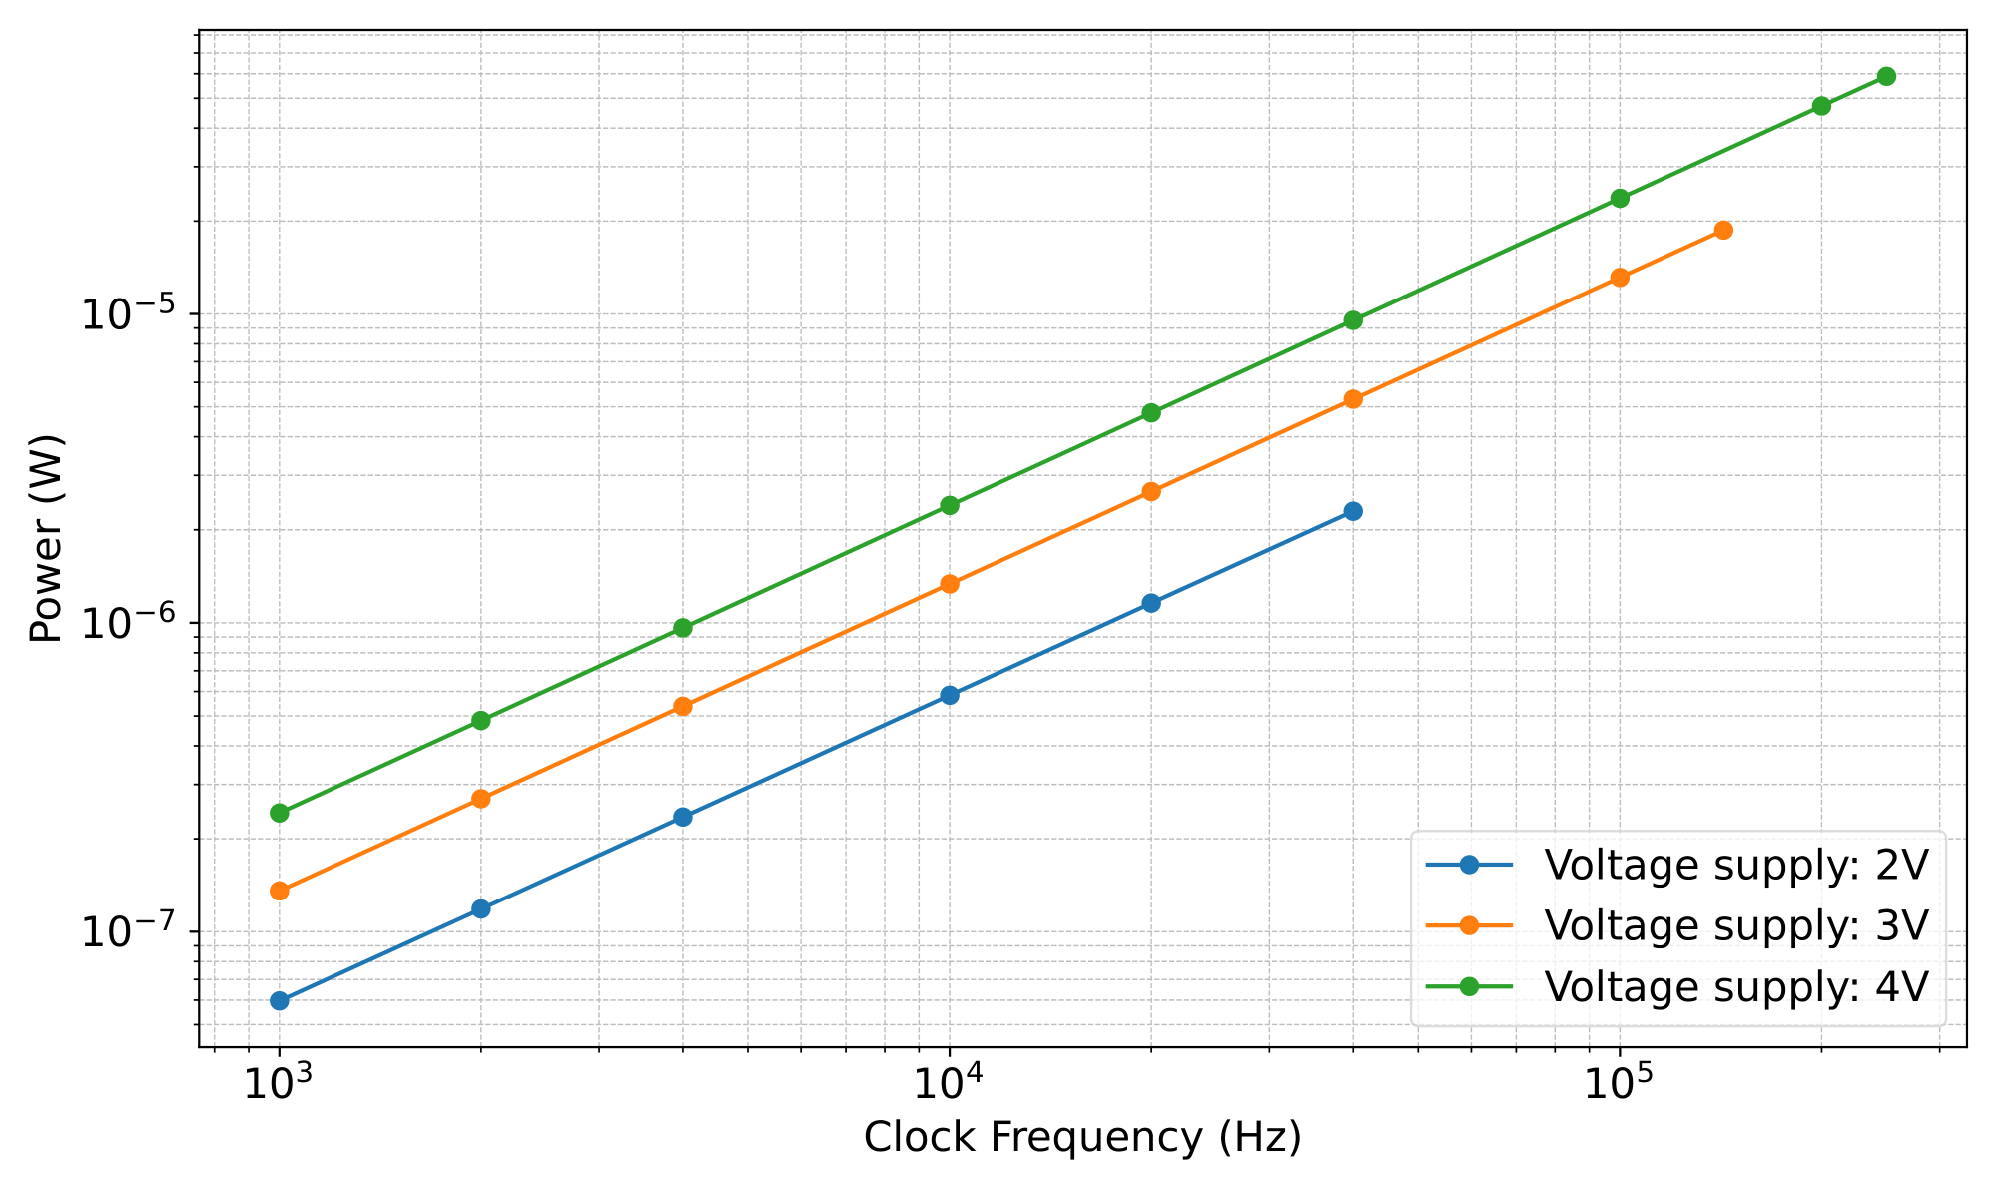
Power on Different Operating Voltages
Differential
Single-ended
Introduction
Methodology
Results
Discussion
Notes:
Grafiek power vs voltage

Slide 28
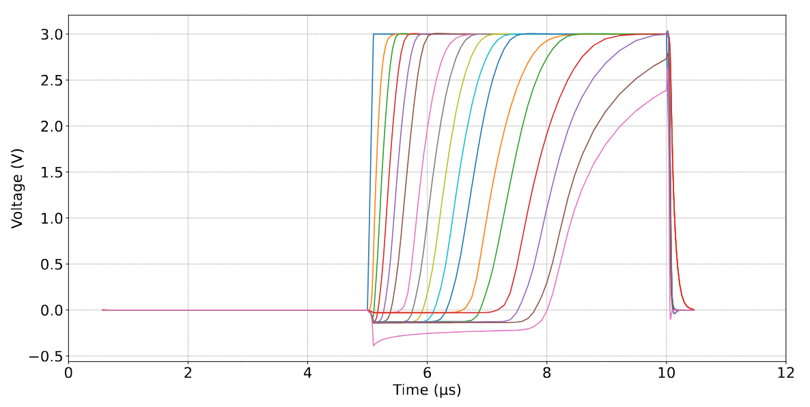
Inconsistent Loads on Delay Cell
Notes:
Extra: voorbeeld single-ended logic

Slide 29
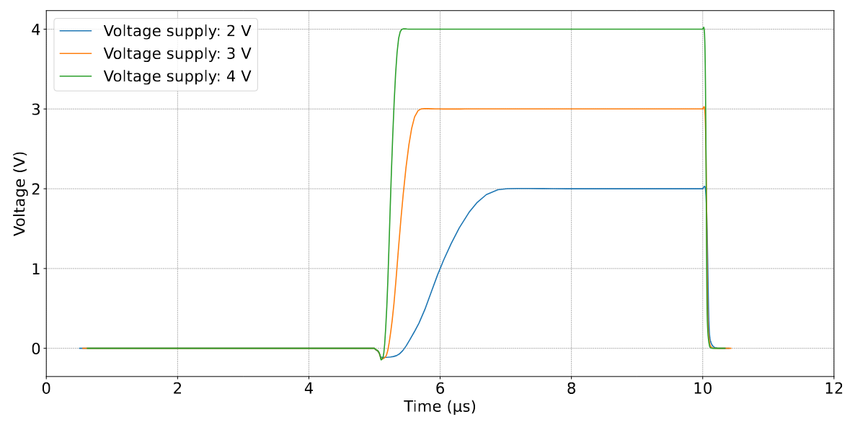
Speed of Delay Cell Based on Power Supply
Notes:
Extra: voorbeeld differential logic

Slide 30
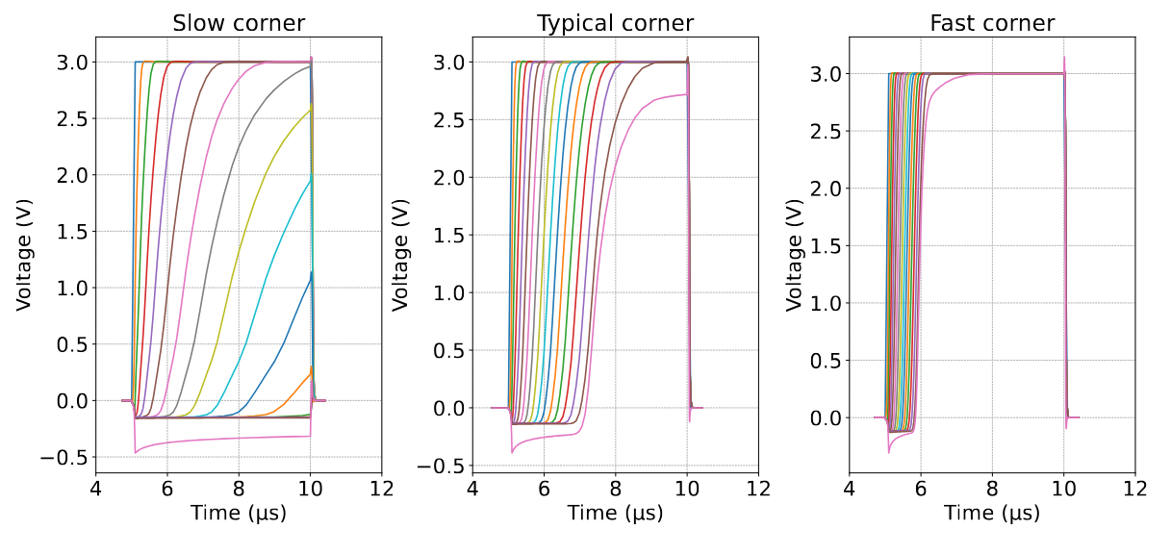
Corners of Delay Cell
Notes:
Extra: Opmaak flipflops

Slide 31
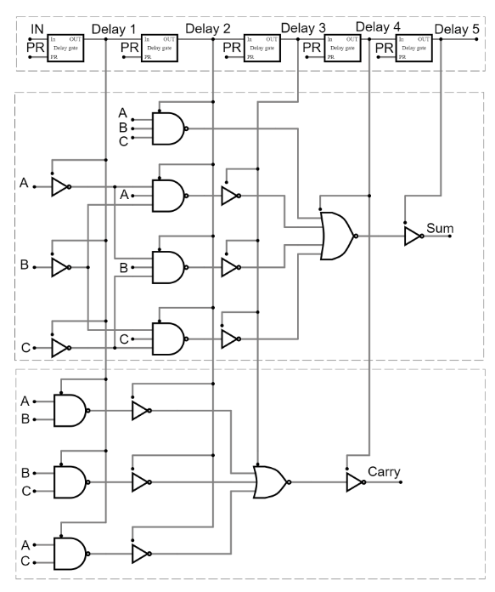
Single-Ended Adder
Notes:
Extra: grafieken die ik niet in de ppt kon aanhalen maar wel in de thesis staan

Slide 32
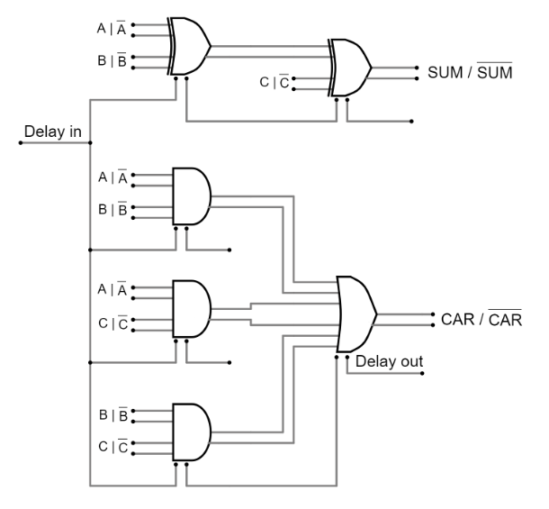
Differential Adder

Slide 33
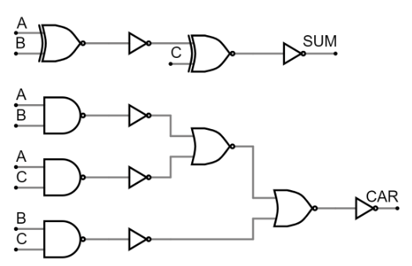
2RLL Adder

Slide 34
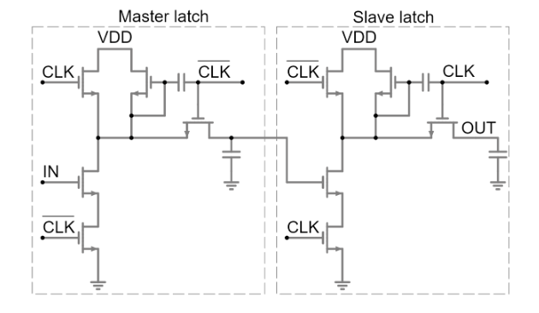
Dynamic Flip-Flop

Slide 35
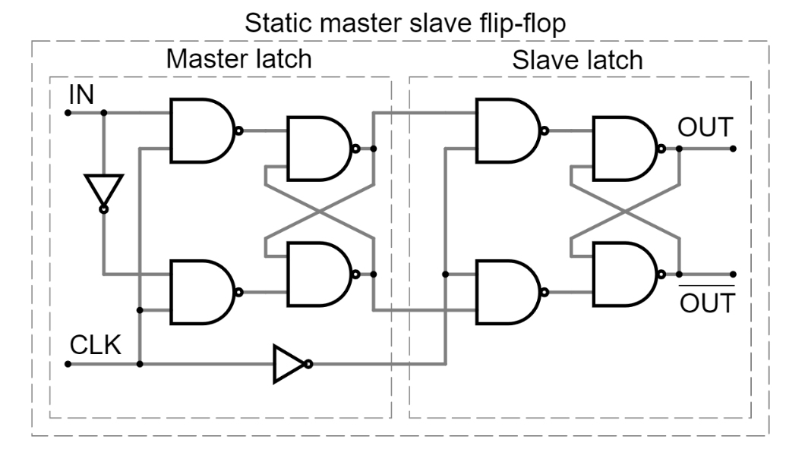
Static Flip-Flop

